Slide 1

Summer Bootcamp
Lesson 1: Getting Started

Slide 2
Course Schedule
Week 1: Getting started and JavaScript/TypeScript basics
Week 2: React basics
Week 3: Creating our first NextJS project
Week 4: Common patterns and tools used at Hack4Impact
Week 5: Tips and tricks

Slide 3
Before we begin…
Assumptions:
Have some coding experience
Will learn HTML and CSS basics on your own
This course will primarily focus on learning TypeScript and React.

Slide 4
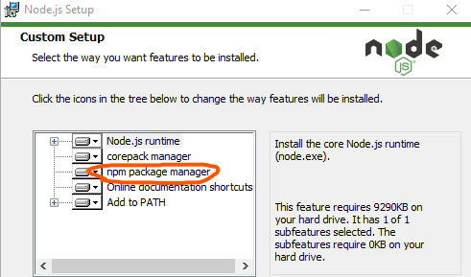
Installing NodeJS
Install the LTS version (link pasted in Discord). Node lets us run JavaScript/TypeScript code on our computers – normally JavaScript can only be run by our browsers.
When installing, make sure the “npm package manager” gets installed as well. npm is the node package manager, and is how we integrate third party code/packages into our projects.
To verify you have installed Node, open a command prompt and type “node --version”

Slide 5
Creating our first project
Install TypeScript using npm
Initialize the TypeScript project
Hello, world!
Run the project

Slide 6
TypeScript primer and weirdness
let vs var vs const
Objects
Types/interfaces
Destructuring
Anonymous functions
async/await

Slide 7
TypeScript primer and weirdness
let vs var vs const
Scoping! Reassignment!
Objects
Types/interfaces
Destructuring
Anonymous functions
async/await

Slide 8
TypeScript primer and weirdness
let vs var vs const
Objects
Think of a hash map from C++ or dictionary from Python
Types/interfaces
Destructuring
Anonymous functions
async/await

Slide 9
TypeScript primer and weirdness
let vs var vs const
Objects
Types/interfaces
Lets us define a shape for objects
Destructuring
Anonymous functions
async/await

Slide 10
TypeScript primer and weirdness
let vs var vs const
Objects
Types/interfaces
Destructuring
Lets us take keys from an object and define a variable from them
Anonymous functions
async/await

Slide 11
TypeScript primer and weirdness
let vs var vs const
Objects
Types/interfaces
Destructuring
Anonymous functions
Quickly define functions to pass to or return from other functions
async/await

Slide 12
TypeScript primer and weirdness
let vs var vs const
Objects
Types/interfaces
Destructuring
Anonymous functions
async/await
Asynchronous code!!

Slide 13
That’s all folks!
See you next Wednesday :)

